Slide 1
Linux device driver
Day 18 PPT
-SUBITHRA s

Slide 2
Profile data
gcc -Wall -pg doubly_linked_list.c main.c -o test_gprof
./test_gprof
gprof test_gprof gmon.out > analysis.txt
Profiling data refers to information collected during the execution of a program that provides insights into its runtime behavior, including details about the time spent in different parts of the code, function call frequencies, and memory usage. Profiling data is useful for identifying performance bottlenecks, optimizing code, and understanding the overall behavior of a program.
When you enable profiling using the -pg flag with the gcc compiler, the compiler inserts instrumentation code into the compiled program. This instrumentation code records information about function calls, their durations, and the flow of execution. This information is then collected during program execution and stored in a file called gmon.Out by default.
Profiling data typically includes:
Function call graph: it shows which functions are called by other functions and how often each function is called. This helps identify which functions consume the most time and which functions are called most frequently.
Time spent in functions: it provides information about the amount of time spent executing each function. Functions that consume a significant amount of time are candidates for optimization.
Memory allocation and deallocation: some profilers also track memory usage, including the allocation and deallocation of memory, helping identify memory leaks and inefficient memory usage patterns.
Hotspots: hotspots are sections of code that are executed frequently or consume a significant amount of time during program execution.

Slide 3
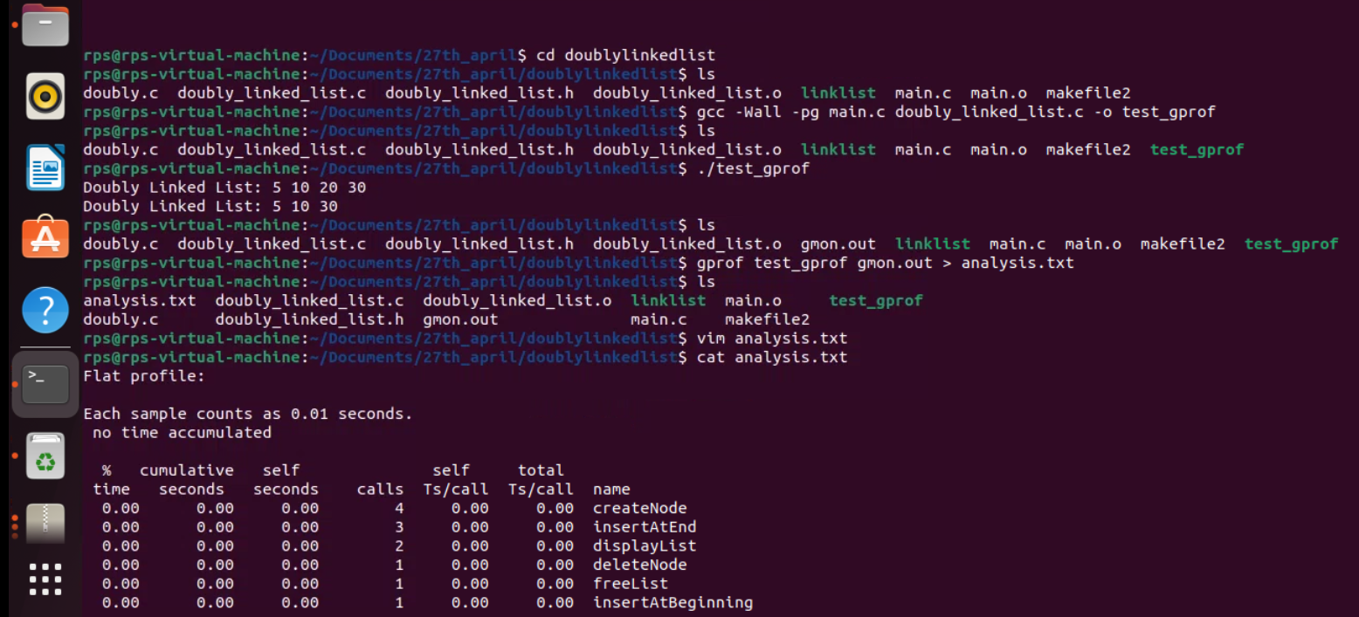
Profile data

Slide 4
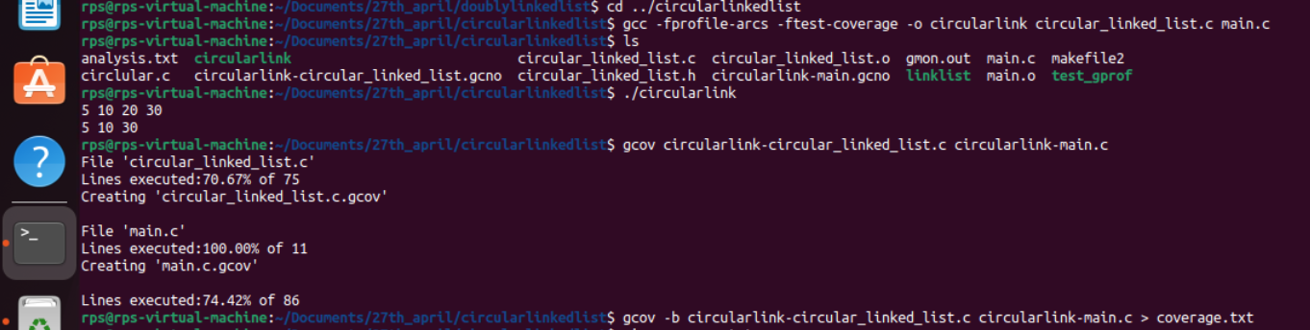
Coverage
Compile your code with coverage flags: First, compile your code with GCC, enabling coverage flags -fprofile-arcs and -ftest-coverage. These flags instruct GCC to generate the necessary profiling information during compilation.
gcc -fprofile-arcs -ftest-coverage -o program program.c
Execute your program as you normally would, either manually or through automated tests.
./program
Generate coverage data: After running your program, GCC will generate coverage data files for each source file. These files have a .gcov extension and contain coverage information for the corresponding source files.
gcov program.c

Slide 5
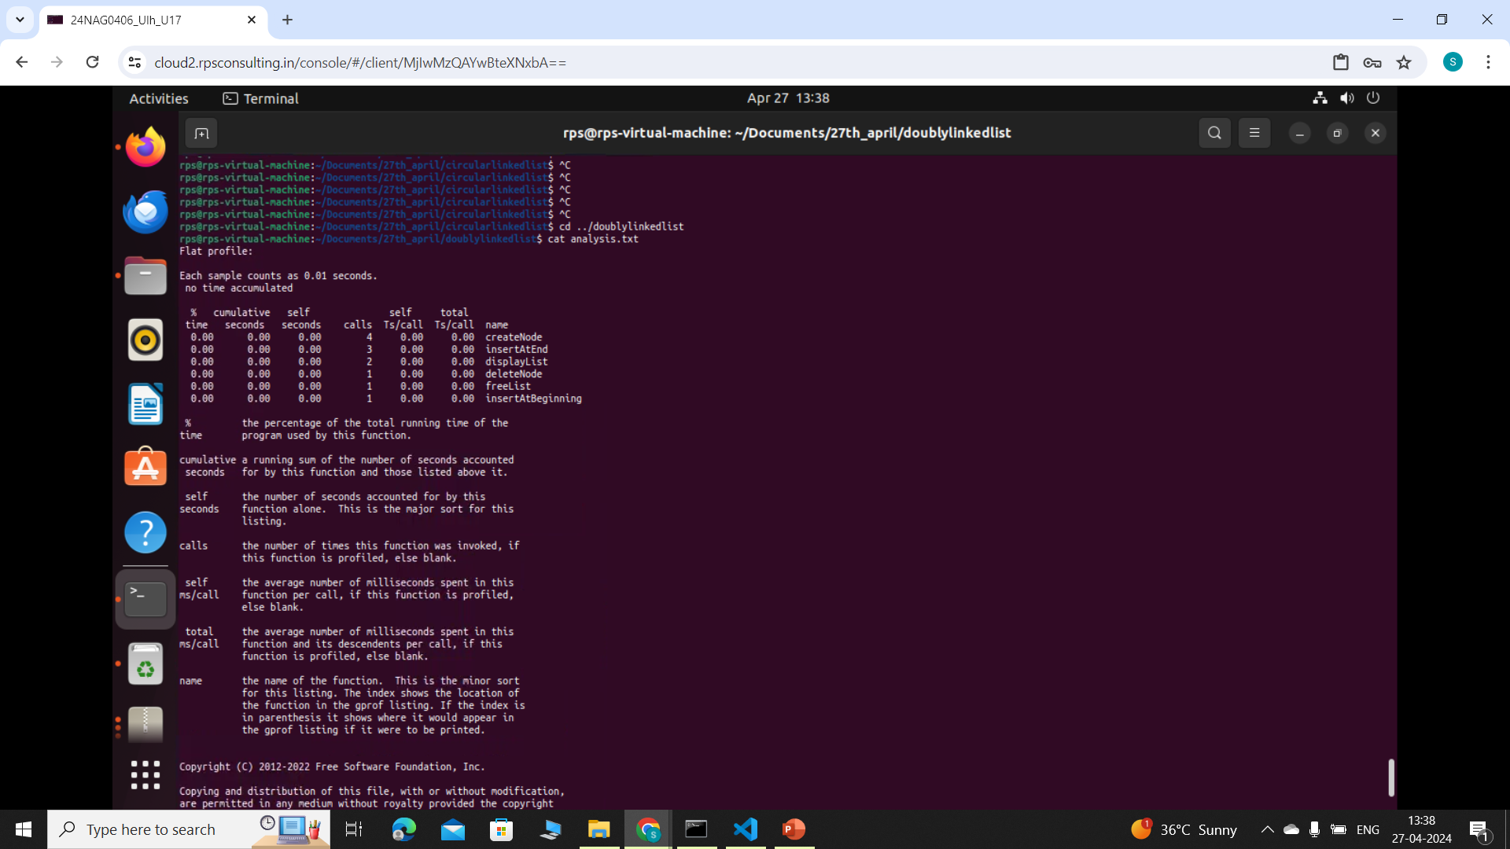
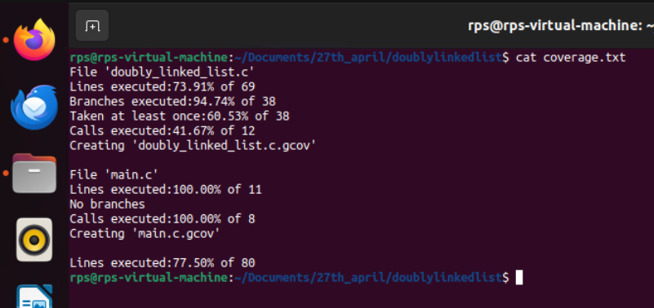
Example of profile data Coverage

Slide 6
THANK YOU

